Slide 1



Notes:
Hi everyone! My name is _______ and I am so excited to be here today to talk to you about something really cool — and really important. It's called underground utility safety. Now, I know that might sound like a mouthful, but I promise by the end of our time together, you are going to know something that most adults don't even think about. And you might even be able to teach your parents something new when you go home today!

Slide 2

What is a Utility?
Notes:
Let me start with a question. Does anyone know what a utility is?
Allow students to answer. Accept all responses enthusiastically — there are no wrong answers here!
Those are great ideas! Let's connect it to your everyday life, because you are actually using utilities all the time without even thinking about it.
*CLICK*
Raise your hand if you've watched Netflix, YouTube, or streamed anything lately. What do you think makes that possible? You need electricity to power your TV or tablet, and you need an internet or fiber optic cable to get the signal to your house. Those are utilities!
*CLICK*
What about cooking dinner? If your family has a gas stove or oven, natural gas is flowing through a pipeline right to your kitchen. That's a utility too!
*CLICK*
And when you wash your hands, take a shower, or flush the toilet — where does the water come from, and where does it go? Water lines bring clean water in, and sewer lines carry the used water away. Yep — more utilities!
Allow students to respond to each example. Keep it interactive and fun.
So a utility is basically any service — electricity, gas, water, internet, phone — that gets delivered to your home through underground cables, pipes, or wires. Pretty much everything that makes life comfortable and fun depends on these systems. Pretty important stuff, right?

Slide 3
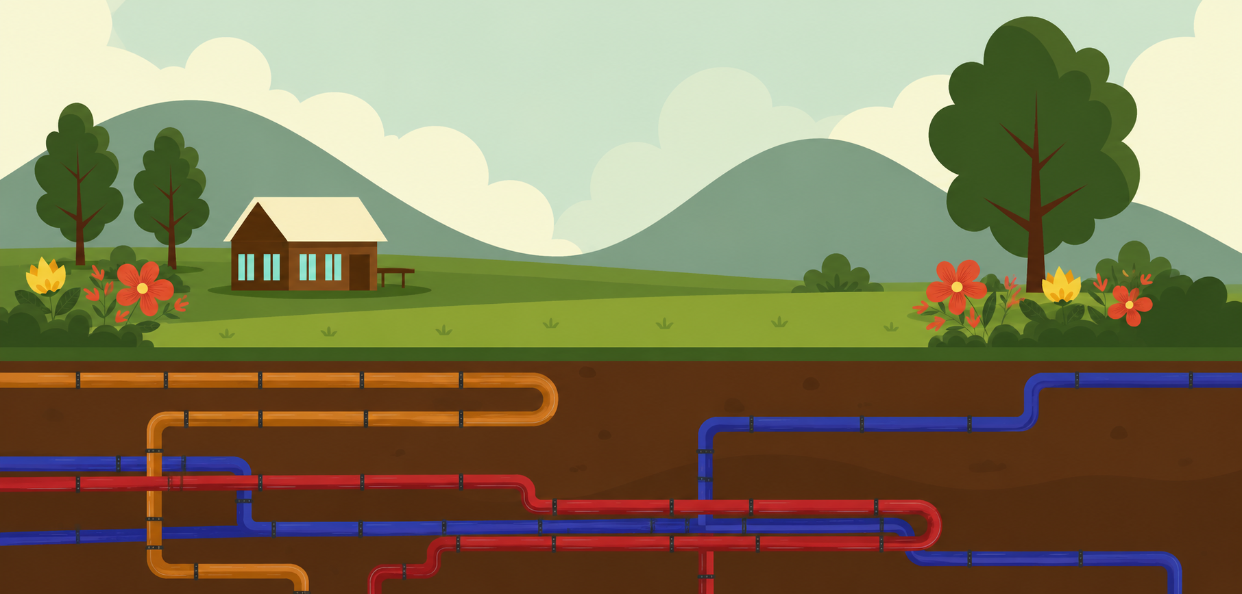
These utilities are buried underground, sometimes just a few inches down!
Your yard, your park, your school, there might be lines right below you.
Notes:
Here is the part that surprises almost everyone. All of those cables and pipes we just talked about? Most of them are buried underground. And not super deep, either — sometimes they are only a few inches below the surface. That means your backyard, the park down the street, even the school playground might have utility lines running right below your feet at this very moment!
Because they can be so close to the surface, even a small digging project — like planting a flower or putting up a fence post — can accidentally hit one of those lines. That is why it is so important to know what's below before any digging starts.

Slide 4
Have you ever seen these before?
These show exactly where underground lines are, and each one has a special meaning
Where you plan to dig
Reclaimed Water
Temporary Mark
Sewer
Water
Electricity
Gas
Telephone & Internet
Notes:
Has anyone ever noticed small colored flags stuck in the ground — maybe in your yard, or at a neighbor's house, or near a construction site? Do you know what they are for?
Allow students to respond. Hold up physical marker flags if you have them — kids love seeing the real thing!
*CLICK*
Those are called utility marker flags! When someone is planning to dig, trained professionals called locators come out and place these flags in the ground to show exactly where the underground utility lines are. That way, anyone doing the digging knows right where to be careful and where not to dig.
And every color means something different. Here is a fun way to remember them:
*CLICK*
White – Where you plan to dig
*CLICK*
Blue – Water
*CLICK*
Purple – Reclaimed water
*CLICK*
Red – Electricity
*CLICK*
Pink – Temporary marking
*CLICK*
Yellow – Gas
*CLICK*
Green- Sewer
*CLICK*
Orange – Telephone & Internet
So if you ever see these flags in your yard or anywhere near a work site, leave them right where they are! They are doing an important job, and moving them could cause a really dangerous problem for whoever is digging nearby.

Slide 5
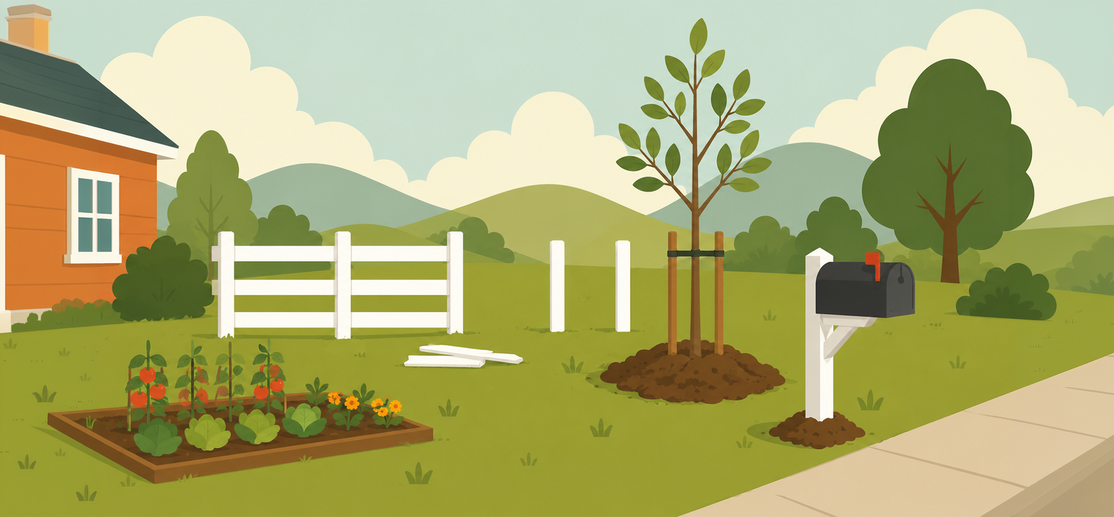
What are some projects around your house that might need digging?
Putting in a new fence
Planting a tree
Planting a garden
Putting in a new mailbox
Notes:
What are some projects around the house that might need digging?
Okay, let's play a little game. I want you to think about your own house and yard. What are some projects that your parents or family might do that would involve digging in the ground?
Allow students to answer the open-ended question and celebrate their responses!
Possible answers: planting a tree, putting up a fence, starting a vegetable garden, installing a mailbox, putting up a basketball hoop, adding a sprinkler system, laying a patio.
Awesome examples! Here is something that surprises most people — it is not just big construction crews with giant machines that need to worry about underground utilities. Even digging with a regular hand shovel in your own backyard counts. If a line is only a few inches underground, a shovel is absolutely enough to hit it. So every single digging project, big or small, needs a locate first.
Here are some examples:
*CLICK*
Putting in a new fence
*CLICK*
Planting a garden
*CLICK*
Planting a tree
*CLICK*
Putting in a new mailbox

Slide 6
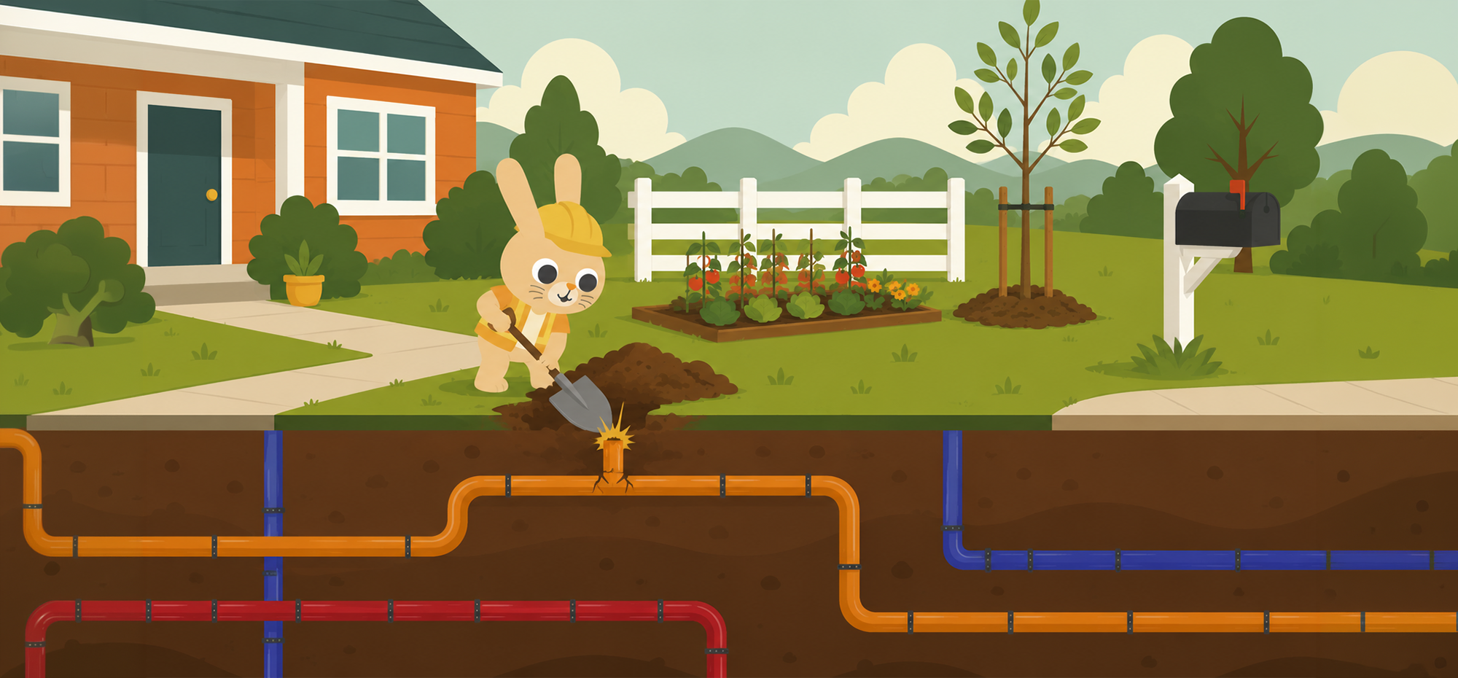
What do you think would happen if you hit a line?
Notes:
What do you think would happen if someone accidentally broke one of those lines?
Alright, here's a big question. What do you think would happen if someone was digging and accidentally broke one of those underground utility lines?
Allow students to answer and react to their guesses before sharing examples. This is a great moment to let the conversation get a little dramatic!
Possible answers: the lights could go out, water could stop working, gas could leak, there could be a fire, the internet could go down.
You all are on the right track! Those are all great answers. This this picture we see an orange telephone & internet line being hit. Lets see what could happen…

Slide 7
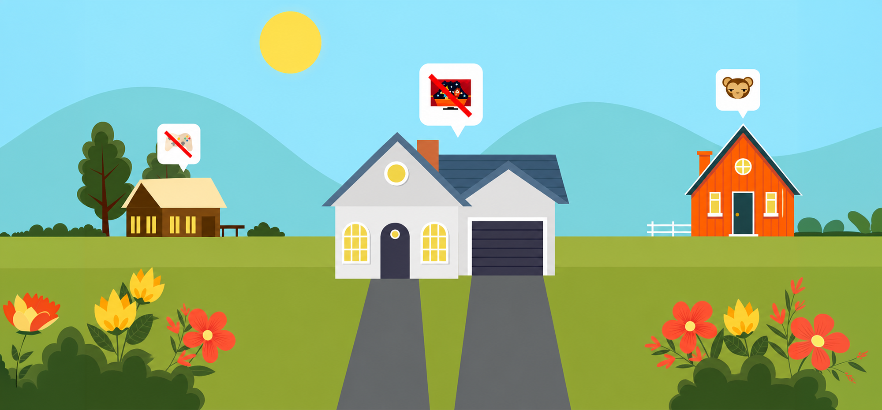
No TV
No fun
No internet
Notes:
Here is the reality:
If someone hits an internet/TV line, it could knock out service for a whole neighborhood.
*CLICK*
No internet.
*CLICK*
No TV.
*CLICK*
No fun.
Additionally,
If someone hits a water line, the whole neighborhood might be without clean water for hours — or even days. No drinking water, no showers, no flushing toilets!
If someone hits a gas line, it can cause a dangerous leak — and families might have to leave their homes until it is fixed.
If someone hits an electric line with a metal shovel... that could cause a very serious electric shock. Not good at all.
And on top of all of that, the utility company can send a bill to the person who did the digging for the full cost of all the repairs — and that can be thousands and thousands of dollars, even if it was a total accident.

Slide 8

Contact 811
JULIE notifies utilities
Locators mark your property
Dig safely
Notes:
The great news is that every single one of those situations is completely avoidable. That is exactly where JULIE and 811 come in!
So what is JULIE, and why does 811 matter so much?
JULIE stands for Joint Utility Locating Information for Excavators. That is a big fancy name, but here is what it really means: JULIE is the friendly, free service in Illinois that makes sure nobody accidentally digs into an underground utility line.
*CLICK*
When you — or your parents — call 811 or go online to JulieBeforeYouDig.com before any digging project,
*CLICK*
JULIE gets in touch with all the utility companies in your area.
*CLICK*
Each company then sends out their own trained locator to visit your property and mark where their lines are.
*CLICK*
Then you practice safe digging.
And the best part? The whole thing is completely free. The call is free. The locators coming out are free. The markings are free. All of it!

Slide 9
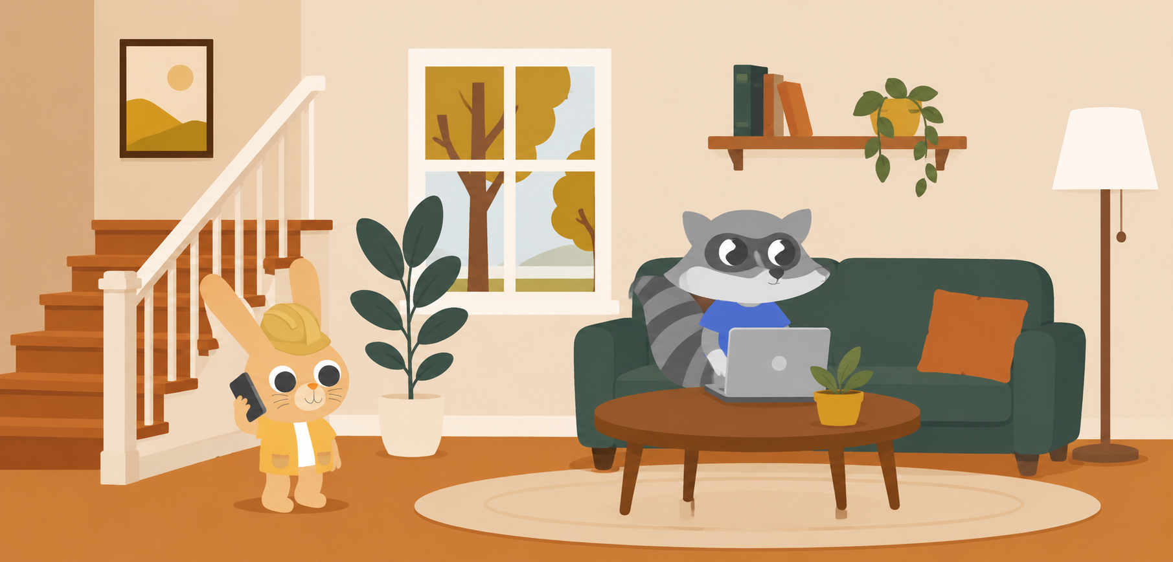
Two Ways to Contact JULIE
Make a Plan First
Go to JulieBeforeYouDig.com
Why are you digging?
Dial 811
Where are you digging?
Who is digging?
When do you need to start?
Notes:
You can call — or you can click!
There are actually two easy ways to get started with JULIE.
*CLICK*
You can call 811 — it connects you right to a friendly JULIE agent who is available 24 hours a day, 7 days a week.
*CLICK*
Or you can go online to JulieBeforeYouDig.com and fill out a quick form to submit your request. Either way works great!
*CLICK*
Before you reach out, it helps to have a little plan ready. Think about things like:
*CLICK*
Why are you digging, and what is the project?
*CLICK*
Exactly where on the property will the digging happen?
*CLICK*
]Who is going to be doing the digging and what tools will they use?
*CLICK*
And when do you want to start? In Illinois, you need to contact JULIE at least 3 full business days before any digging begins — so plan ahead!
Once you have those answers, make the call or click submit. JULIE takes it from there!

Slide 10


After You Contact JULIE
Let’s see what you remember:
What do the colors mean?
Locators visit and mark all the underground lines with flags & paint
Notes:
After you contact JULIE, the utility companies send out their locators. A locator is a trained professional whose whole job is to visit your property, figure out exactly where their company's underground lines are, and mark them with those colored flags and paint we talked about. They are kind of like underground detectives! 🕵️
*CLICK*
*CLICK*
Speaking of those flags — let's see how well you remember your colors! I'll give you a color and you tell me what's underground. Ready?

Slide 11


What does green mean?
Sewer!
Notes:
Do you remember what green means?
*CLICK*
Green means sewer

Slide 12

What does orange mean?
Telephone & Internet!
Notes:
What does orange mean?
*CLICK*
Orange means telephone and internet

Slide 13

What does red mean?
Electricity!
Notes:
What does red mean?
*CLICK*
Red means electricity

Slide 14

What does yellow mean?
Gas!
Notes:
What does yellow mean?
*CLICK*
Yellow means gas

Slide 15

What does white mean?
Where you plan to dig!
Notes:
What does white mean?
*CLICK*
White shows where you plan to dig

Slide 16
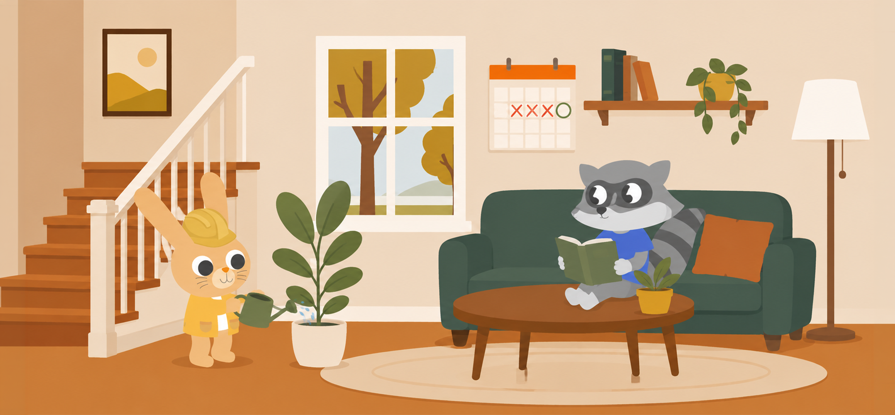
Wait the Required Time
In Illinois, you must wait at least 3 full business days after contacting JULIE before you start digging
Notes:
Wait the required time — patience is key!
Once you have contacted JULIE, there is one more important step before anyone picks up a shovel: you have to wait.
*CLICK*
Illinois law says you must wait at least 3 full business days after your request before any digging starts. This gives every utility company enough time to send their locator out and get everything properly marked.
It might be tempting to just get started — especially if it's a fun project like planting a garden or putting up a basketball hoop. But rushing past this step is exactly how accidents happen. Good things come to those who wait, and in this case, waiting keeps everyone safe!

Slide 17

Check Your 811 Ticket
Notes:
Check the response and get the all clear
Before anyone breaks ground, log back in to JulieBeforeYouDig.com or check your 811 ticket to make sure you have received a response from all of the utility companies and that everything is marked and ready to go. This is called getting the all clear. If something does not look right, or a utility has not yet responded, give JULIE a call before you do anything else. Better safe than sorry!

Slide 18
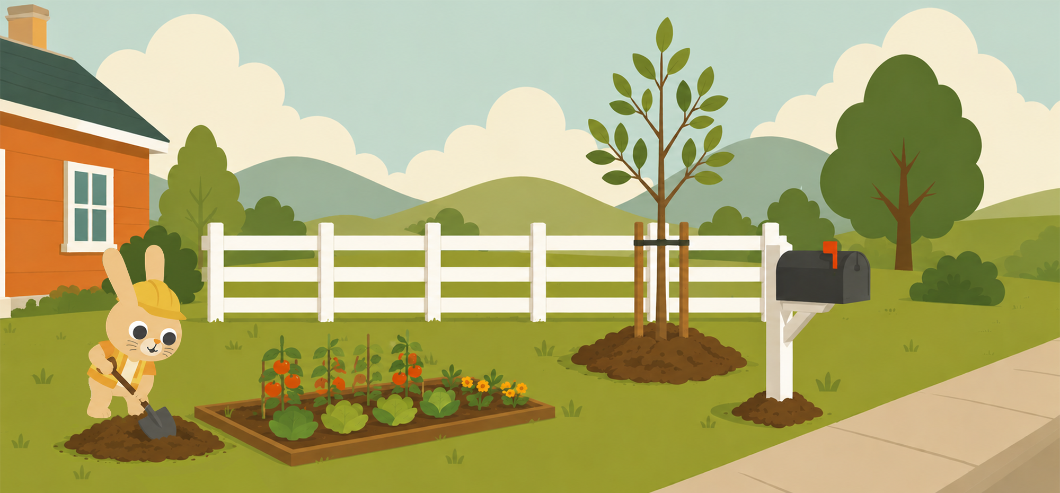
Dig with C.A.R.E.
C — Call or click before you dig
A — Allow required time for marking
R — Respect the marks
E — Excavate carefully
Notes:
Now you're ready to dig — with C.A.R.E.!
Alright — you've made your plan, you've contacted JULIE, you've waited, and you've got the all clear. You are ready to dig! Just remember to always do it with C.A.R.E.:
*CLICK*
C – Call or click before you dig. Every single time, no exceptions. It is the most important step of all!
*CLICK*
A – Allow required time for marking. Give it the full 3 business days. Every line needs to be marked before the first shovel goes in.
*CLICK*
R – Respect the marks. Those flags and painted lines are protecting people. Never move them, kick them over, or ignore them — they are doing an important job!
*CLICK*
E – Excavate carefully. When you are digging near marked areas, use hand tools first to find the exact location of the lines before switching to any power equipment.

Slide 19



Contact JULIE before you dig!
Notes:
So the next time your parents are talking about a project in the yard — planting a tree, putting in a garden, building a fence — you can be the one who reminds them: "Hey, did you call 811?" You might just be the smartest person in the room! 😄
Thank you so much for being such a great audience today. You have learned something really important, and I hope you share it with your families. Remember — 811 and JulieBeforeYouDig.com, always before you dig!

